Slide 1
CIMIC Key Leaders’ Conference Tirana 27 to 30 May 2019
Tonin MARKU,
Brig-Gen, ALB-A
ACOS J9, SHAPE

Slide 2
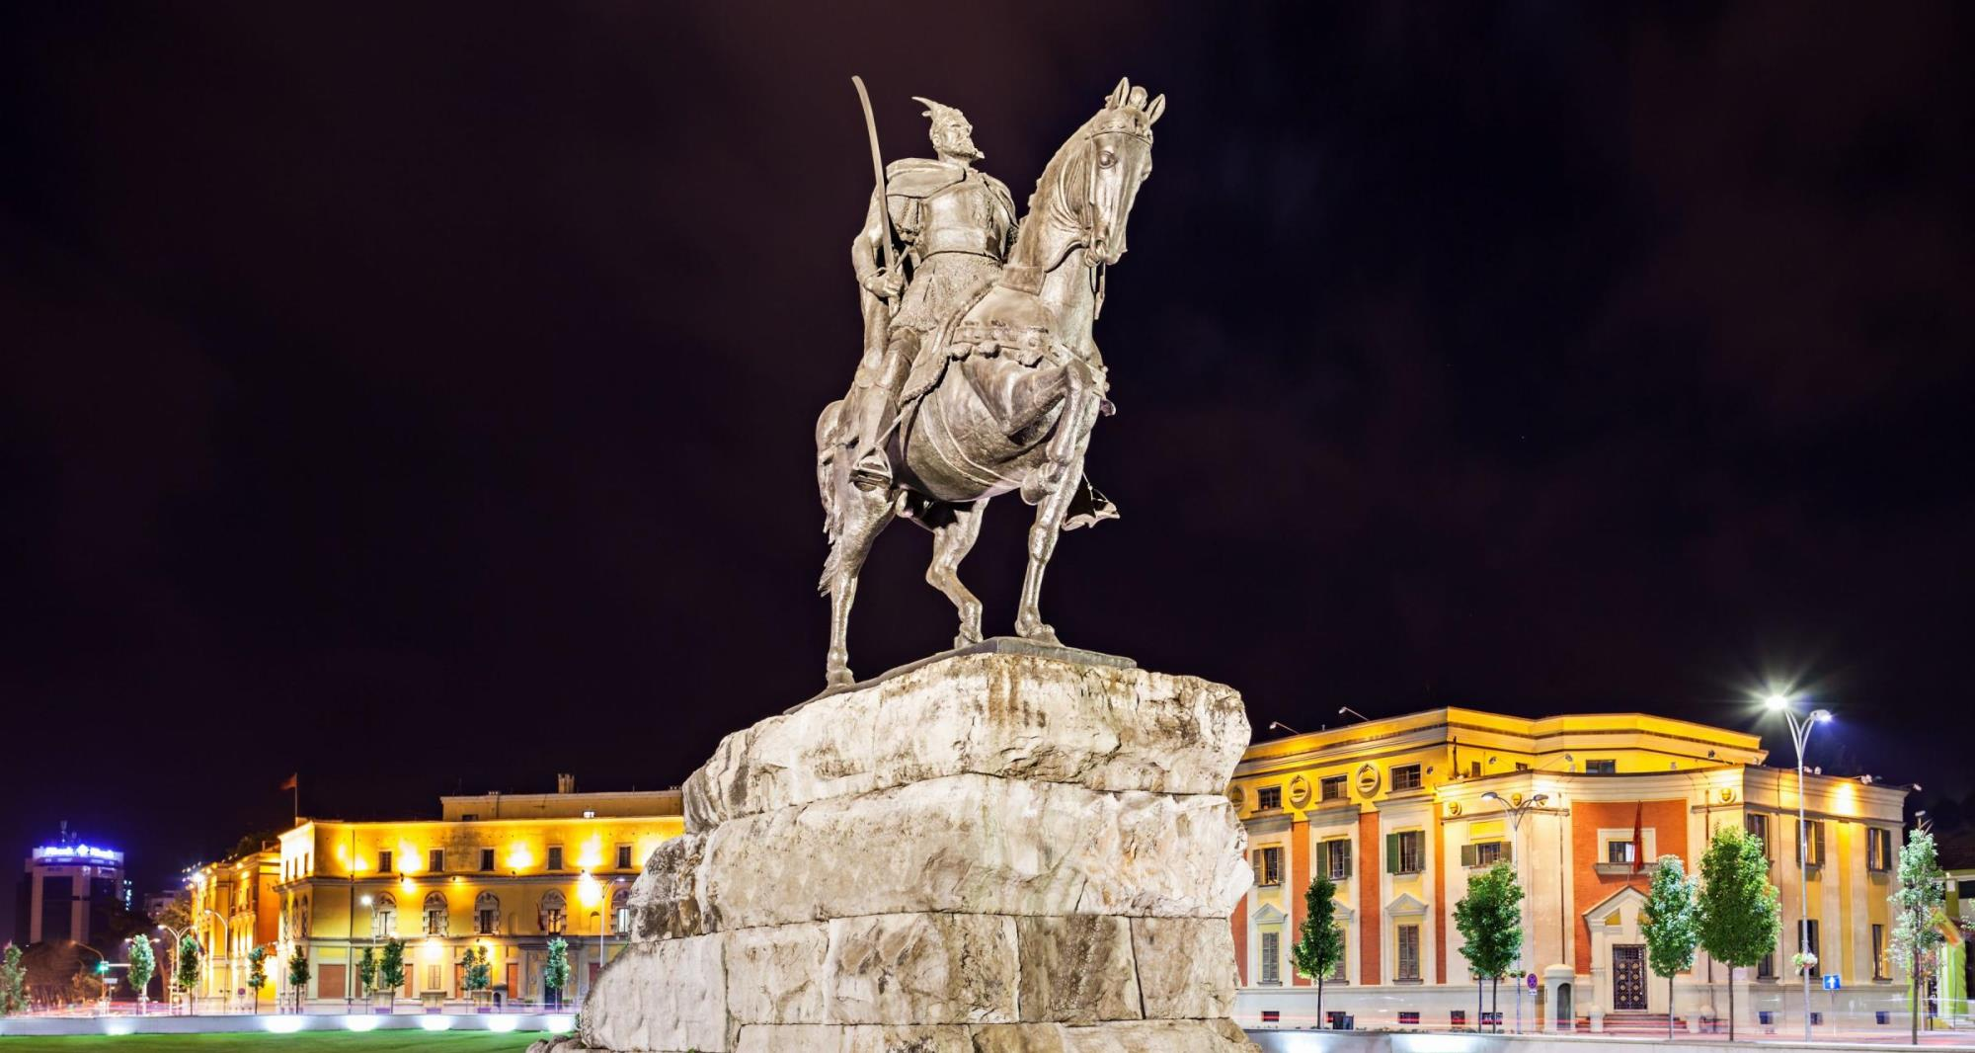
“NATO CIVIL MILITARY COOPERATION VISION 25” CIMIC Key Leader Conference 2019, Tirana
WELCOME TO TIRANA

Slide 3
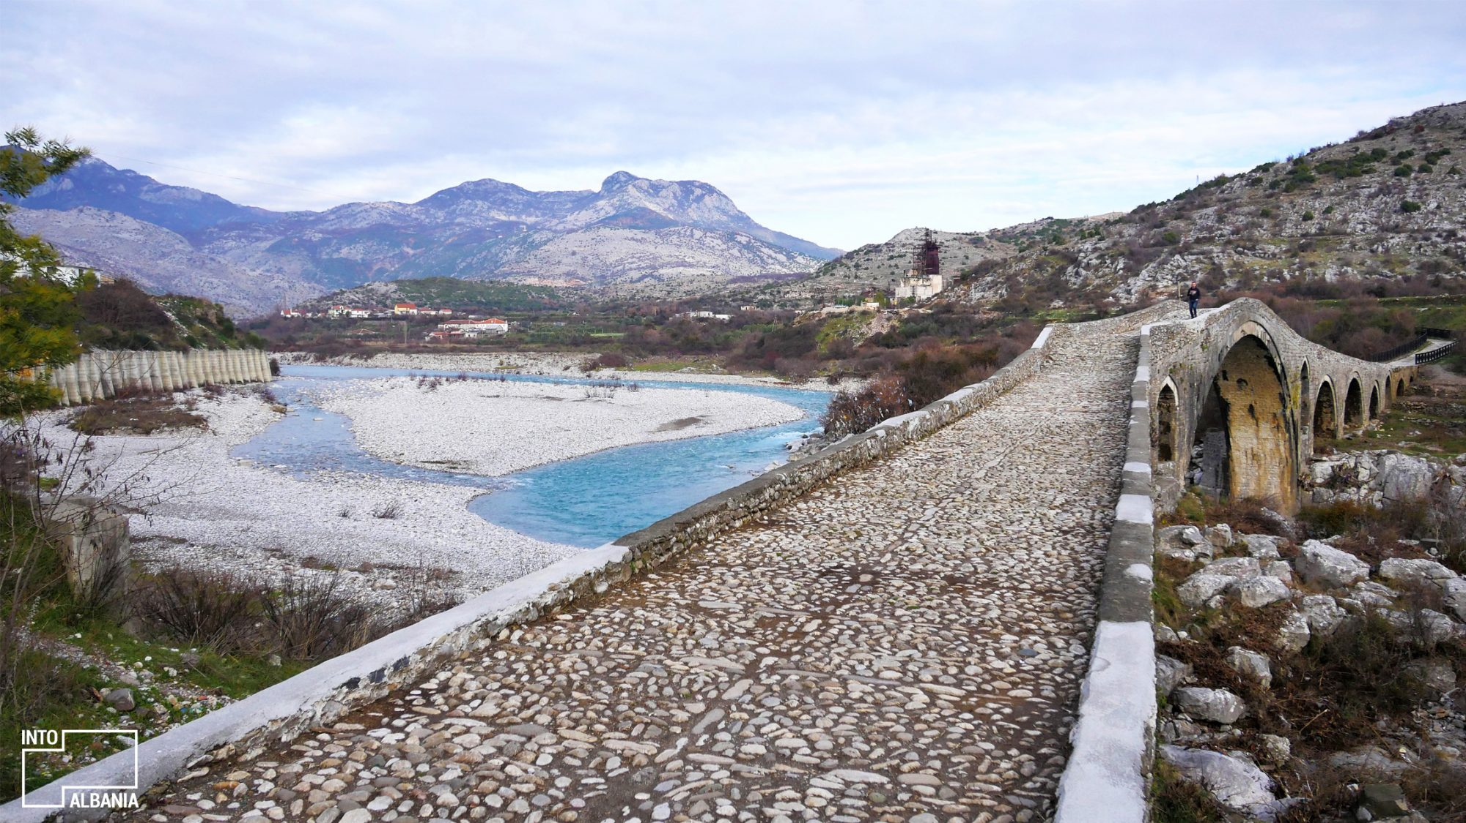
“NATO CIVIL MILITARY COOPERATION VISION 25” CIMIC Key Leader Conference 2019, Tirana
CKLC 19: Achievements 2017-19
Collective Defense – Enhance
Cooperative Security – Develop
Crisis Management - Sustain
Doctrine –new CIMIC Doctrine
Organization – NATO Command Structure Adaptation
Training – review of CIMIC Training and Education
Leadership – Commanders leading from the front
Personnel –a motivated & capable CIMIC team
Interoperability – enhanced Civil Military relationships

Slide 4
“NATO CIVIL MILITARY COOPERATION VISION 25” CIMIC Key Leader Conference 2019, Tirana
CKLC 19: Participation
Albanian Ministry of Defence
Allied Command Operations:
SHAPE
Joint Force Command Brunssum
Joint Force Command Naples
European Union
African Union
United States European Command
NATO Headquarters
Supreme Allied Command Transformation
US Civil Affairs Proponency, Special Operation Center of Excellence
Romanian Ministry of Home Affairs
The Geneva Centre for Security Sector Governance
International Centre for Defence and Security

Slide 5
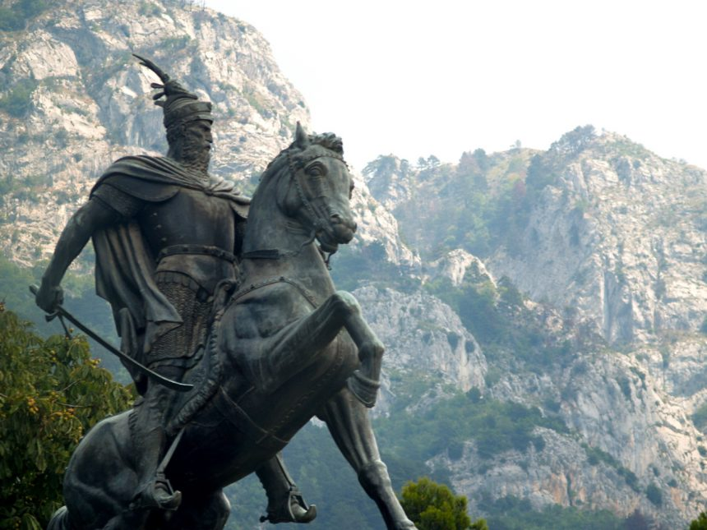
“NATO CIVIL MILITARY COOPERATION VISION 25” CIMIC Key Leader Conference 2019, Tirana
CKLC 19: Aim
To discuss strategic trends in the civil operating environment in order to inform the development of NATO CIMIC in terms of Doctrine, Organisation, Training, Materiel, Leadership, Personnel, Facilities and Interoperability.

Slide 6
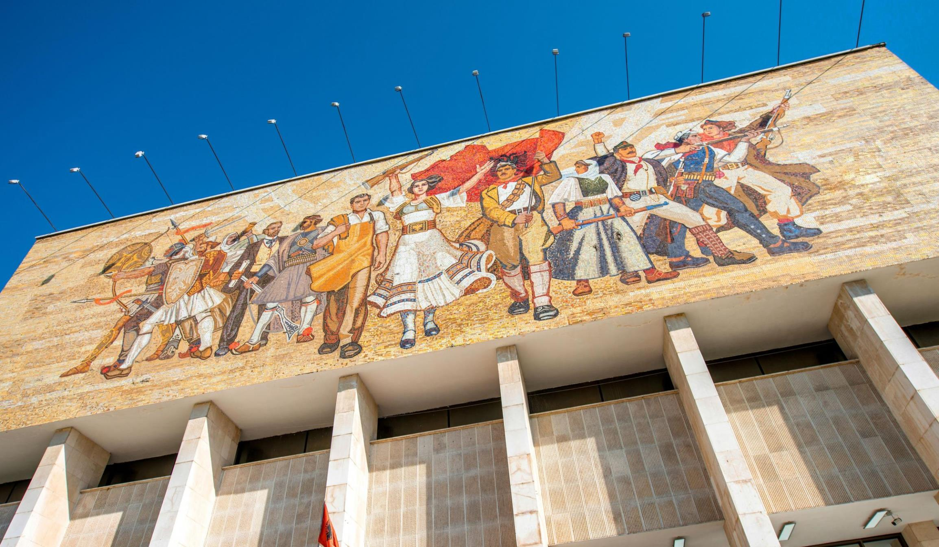
“NATO CIVIL MILITARY COOPERATION VISION 25” CIMIC Key Leader Conference 2019, Tirana
CKLC 19: Objectives
ACO CIMIC and CMI Role in countering ‘Hybrid’ threats and Resilience through Civil Preparedness.
ACO CIMIC and CMI contribution to Projecting Stability and Counter Terrorism overseas.

Slide 7
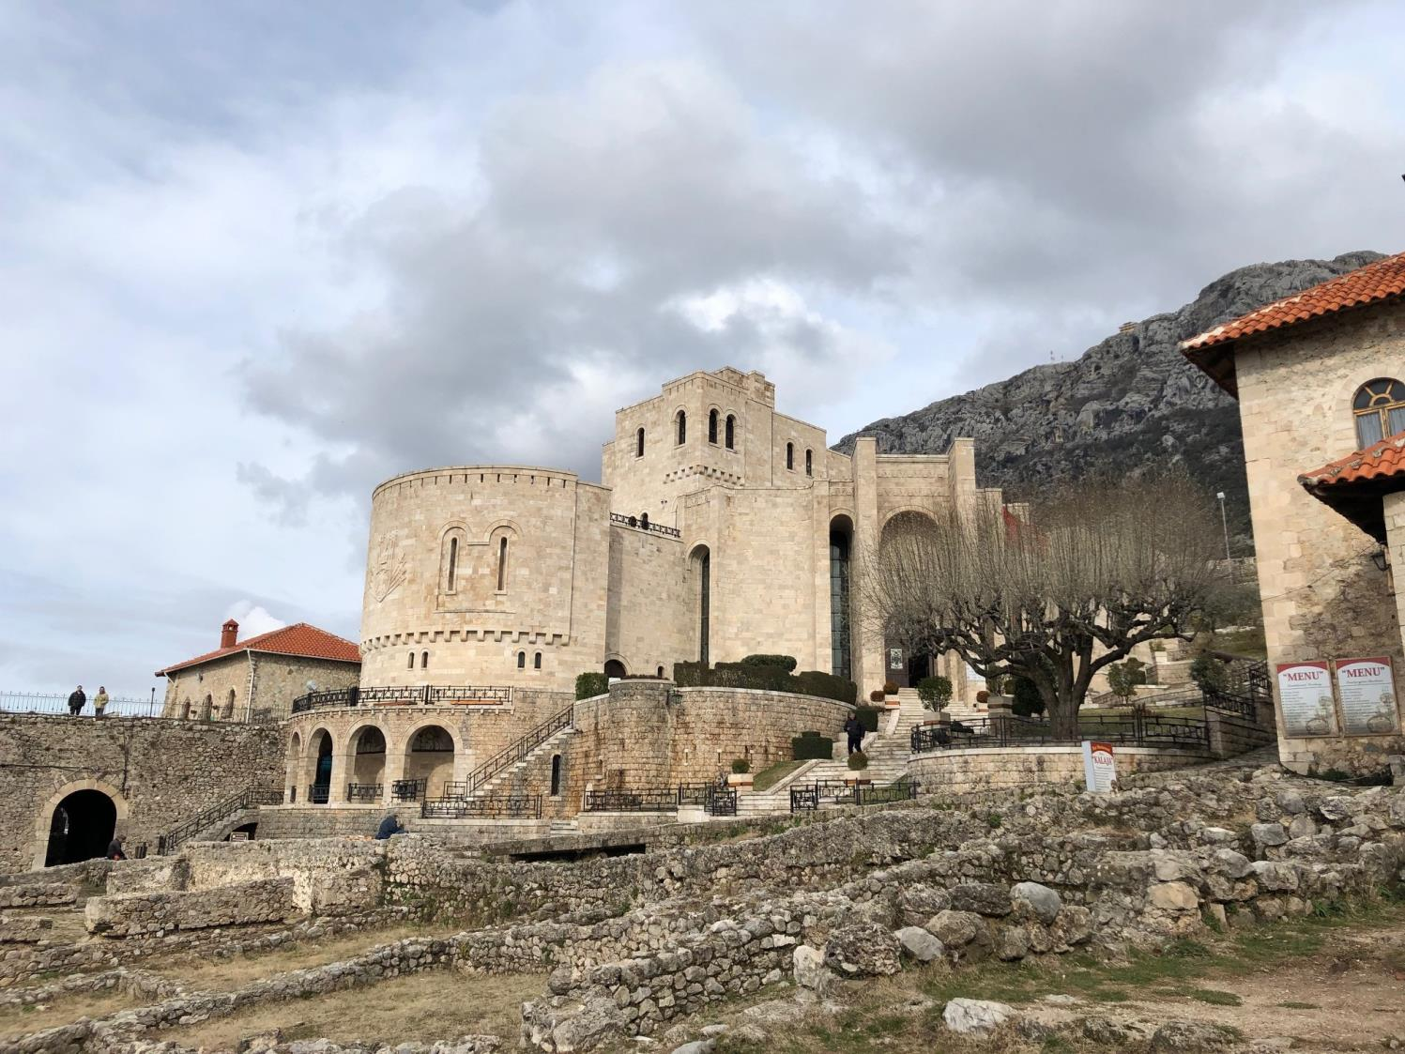
CKLC 19: Workshops
Resilience through Civil Preparedness
Projecting Stability & Counter Terrorism
Training & Education
Leadership & Personnel
Interoperability & Cooperation

Slide 8
PETRO KOÇI
Deputy Minister of Defense, Albania

Slide 10
CIMIC Key Leaders’ Conference Tirana 27 to 30 May 2019
Tonin MARKU,
Brig-Gen, ALB-A
ACOS J9, SHAPE

Slide 11
CKLC 19: Closing Remarks
Thanks
Speakers
Chairmen
Hosts & Staff
SHAPE J9 & CCOE Organisers
Look Forward
Kruja Castle Tour
Steering Committee
Farewell

Slide 12
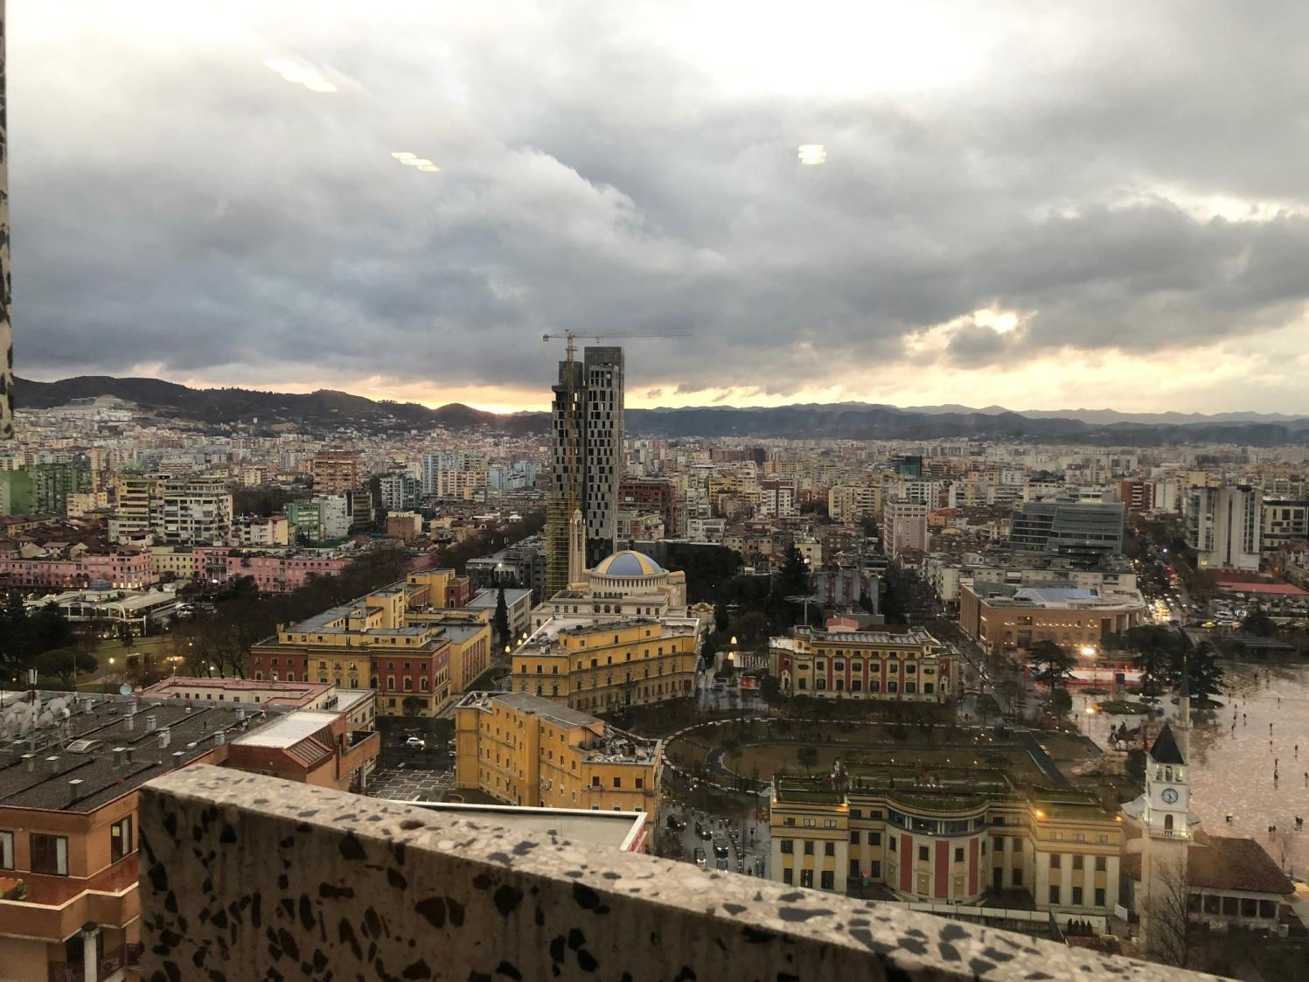
Safe Journey Home
Albanian Greeting?

