Slide 1
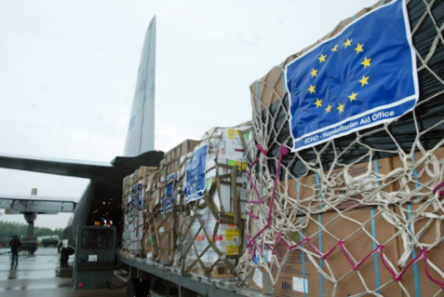
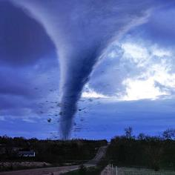
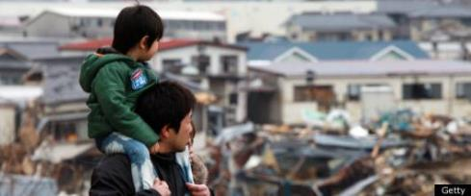
Hybrid Threats & Resilience through Civil Preparedness
An EU View
NATO CIMIC Leaders’ Conference
Tirana, 27 May 2019
Apostolos NIKOLAIDIS
Civil-Military Relations Officer
European Commission
Directorate-General for European Civil Protection and Humanitarian Aid Operations (DG ECHO)
Unit E1, International & Interinstitutional Relations, Legal Framework

Slide 2
DG ECHO: TWO COMPLEMENTARY TOOLS
 | HUMANITARIAN AID | CIVIL PROTECTION
What? | DG ECHO as major donor: programming and policy development | DG ECHO as coordinator: voluntary contributions of in-kind assistance from Participating States
How much? | EUR 1 billion in 2018 | EUR 35 million in 2018
To whom? | Implementing partners | Governments of disaster affected countries
Geographical scope? | Most vulnerable populations in third countries, mainly in developing countries | Inside and outside the EU
Type of disaster? | Natural and man-made disasters (complex emergencies, wars, conflicts, forgotten crises etc.) | Natural and man-made disasters (complex emergencies exceptional)
Timescale? | Immediate aftermath of crisis and beyond Depending on humanitarian needs | Acute stage only Normally first few weeks after a disaster

Slide 3
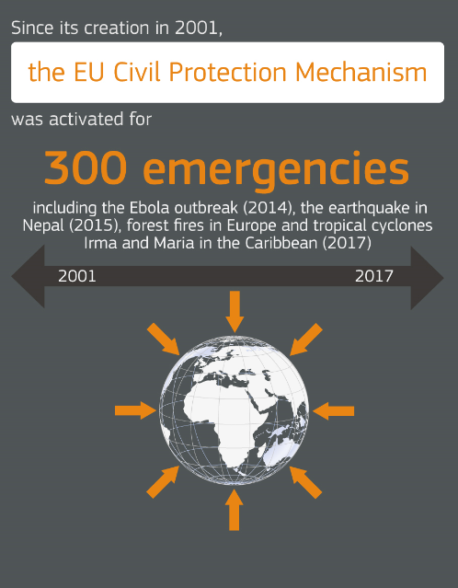
Union Civil Protection Mechanism (UCPM)
Enhanced cooperation in the field of civil protection amongst 34 Participating States
28 EU Member States + Iceland, Montenegro, Norway, Serbia, North Macedonia, Turkey
Prevention
Risk assessment
Risk management capability
Risk management planning
Preparedness
Training
Exercises
Exchange of experts
Response
European Emergency Response Capacity (EERC – "Voluntary Pool")
EU Civil Protection Teams (EUCPT)
Transport
Notes:
What is Civil Protection? Governmental in-kind assistance (experts, teams and equipment) delivered in the immediate aftermath of a disaster.
Three dimensions of the Mechanism, which supports Participating States during the whole disaster management cycle:
1. Prevention : Support MS in preventing risks or reducing harm to people, environment or property resulting from emergencies
2. Preparedness : Training, exercises, exchanges of experts, modules
3. Response : Facilitate cooperation and coordination in responding to disasters inside and outside the EU.
34 Participating States in the EUCPM: 28 MS + Iceland, Norway, Montenegro, North Macedonia, Serbia and Turkey
These countries pool their resources together to tackle emergencies.
Role of the Mechanism=
To facilitate cooperation in CP assistance interventions
Making support available on request of the affected country
To coordinate the incoming assistance to the affected country

Slide 4
Notes:
ACTIVATION OF THE MECHANISM
An affected country requests assistance to the ERCC.
The ERCC forwards the request to the national contact points. The national contact points then assess their available resources and inform the ERCC whether or not they can help.
The ERCC compiles responses and informs the affected country of available assets.
The affected country selects the assistance it needs and establishes contact with the assisting countries.
The ERCC then liaises between the offering and the requesting country to ensure the prompt delivery of the accepted assistance.
→ All in CECIS (Common Emergency Communication and Information System)

Slide 5
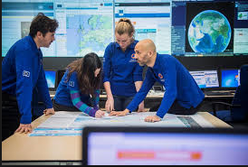
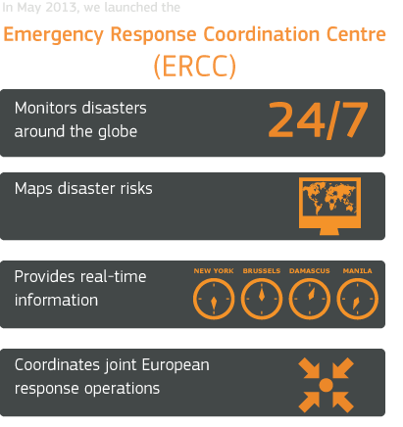
Notes:
The ERCC is the operational heart of the EUCPM
It works 24/7
Multi-layered coordination: within DG ECHO, with EC and other EU bodies (EEAS, DG SANTE…), with Member States and the international community
ERCC facilitates mobilisation, deployment and coordination of ressources

Slide 6
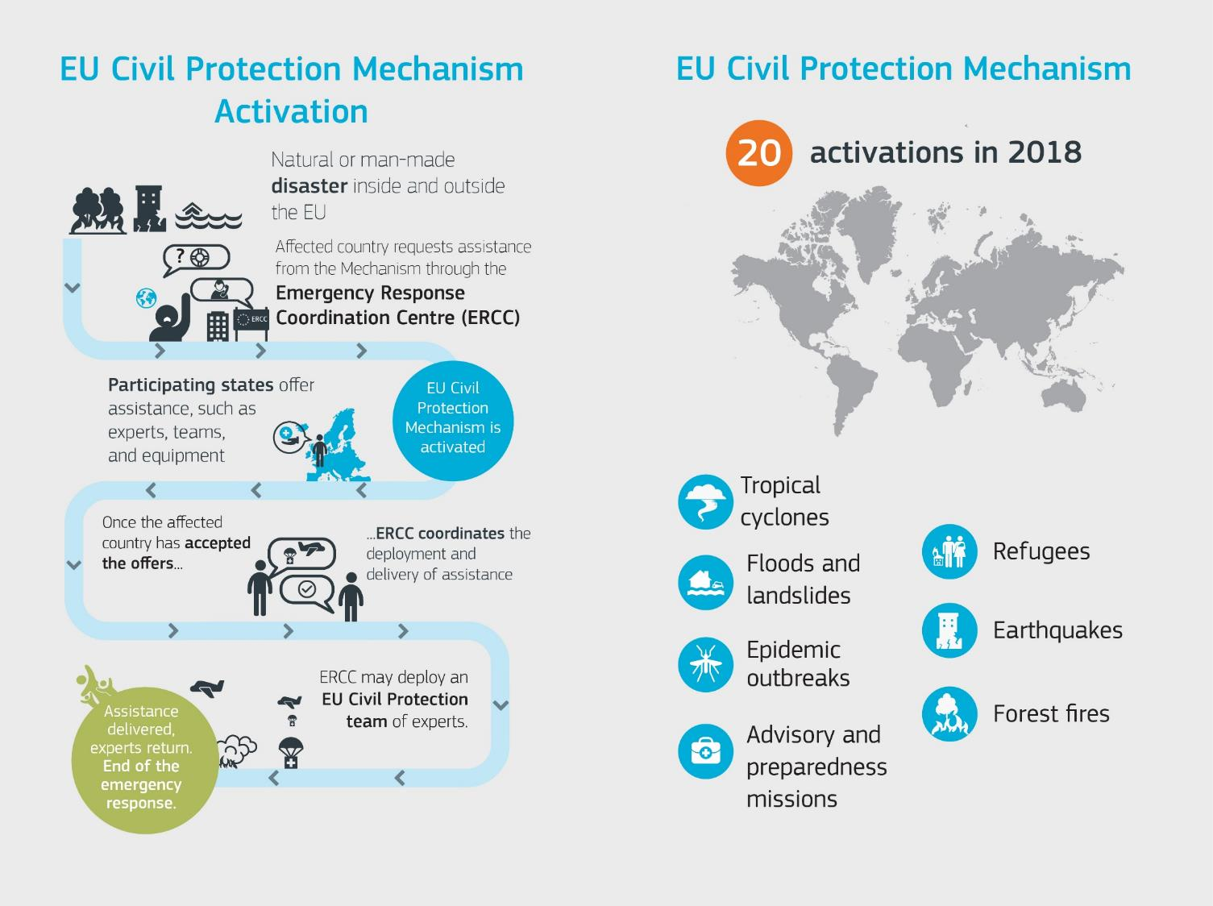

Slide 7
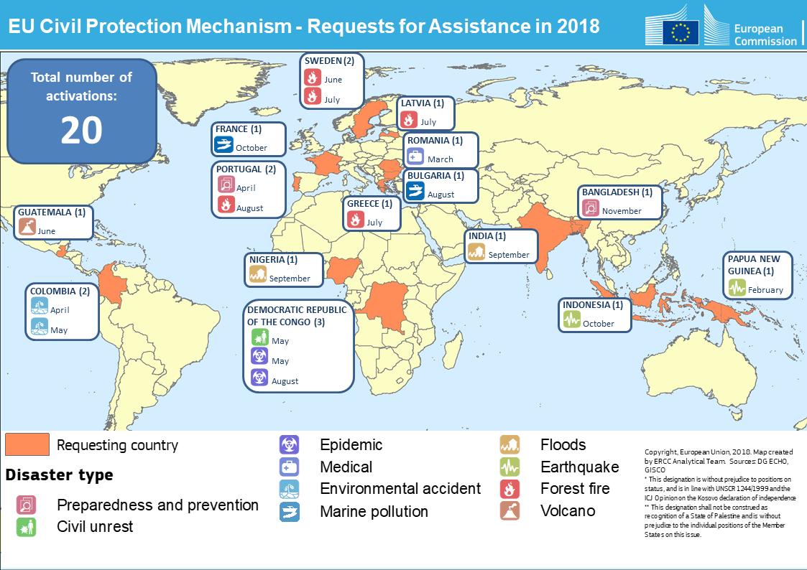
Notes:
EUCPM reacts to very diverses disasters
Natural disasters
Floods, earthquakes, forest fires, cyclones
Manmade disasters
Environmental disasters
Complex emergencies (Iraq, Syria)
Health emergencies
Ebola epidemic – West Africa
Yellow Fever - Democratic Republic of Congo
Assistance to consular support
Terrorist attacks (medical evacuation Mumbai)
Evacuation of EU citizens → transport cofinancing

Slide 8
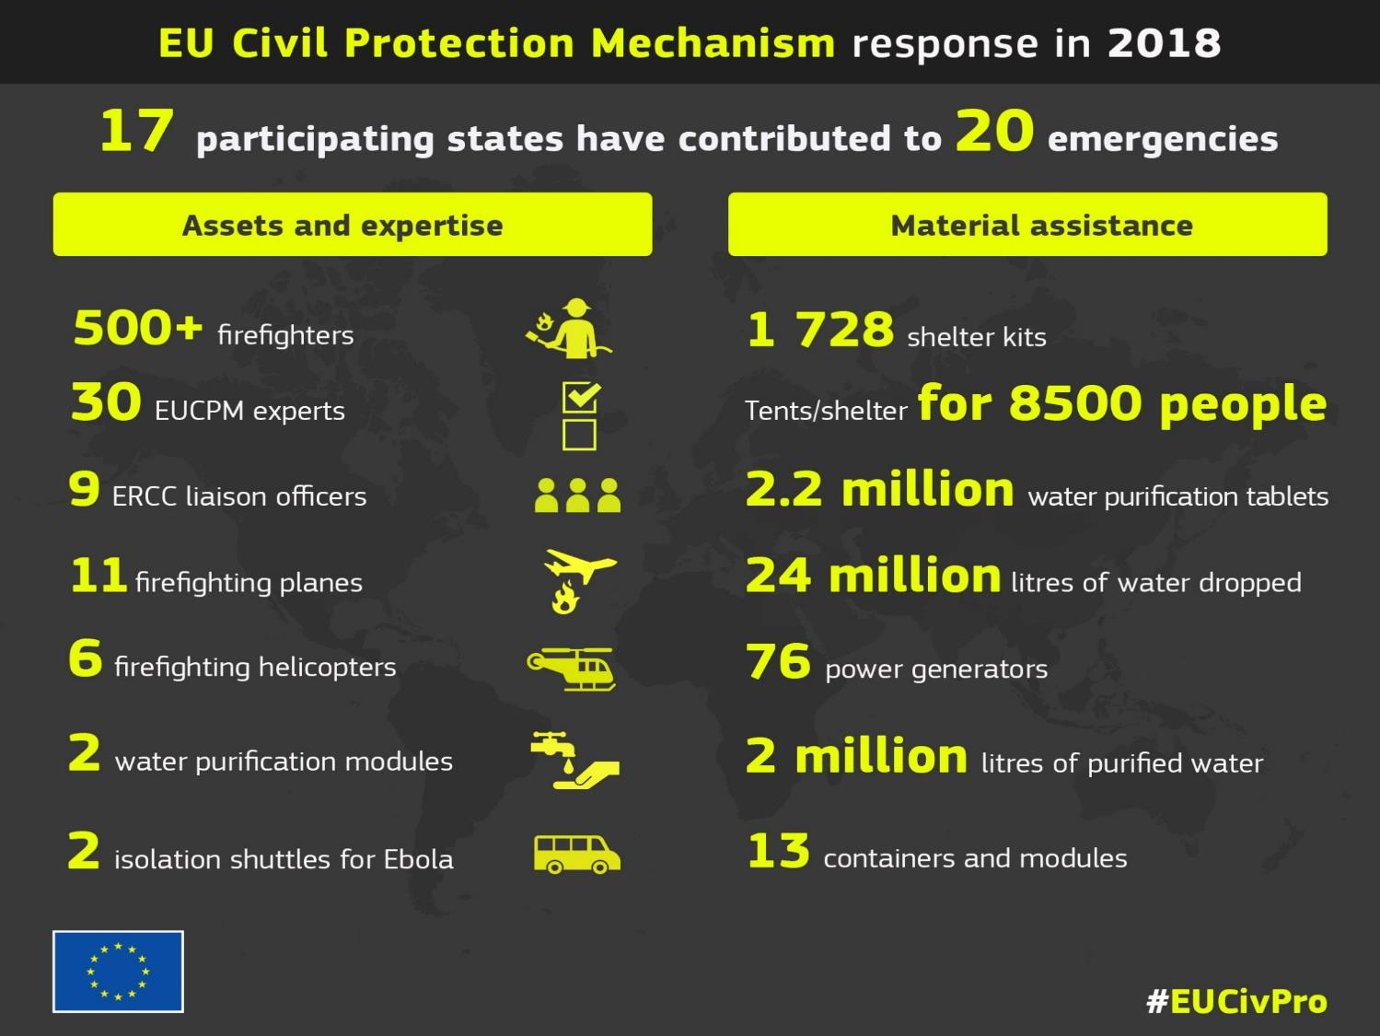
Notes:
Some examples of assistance delivered

Slide 9
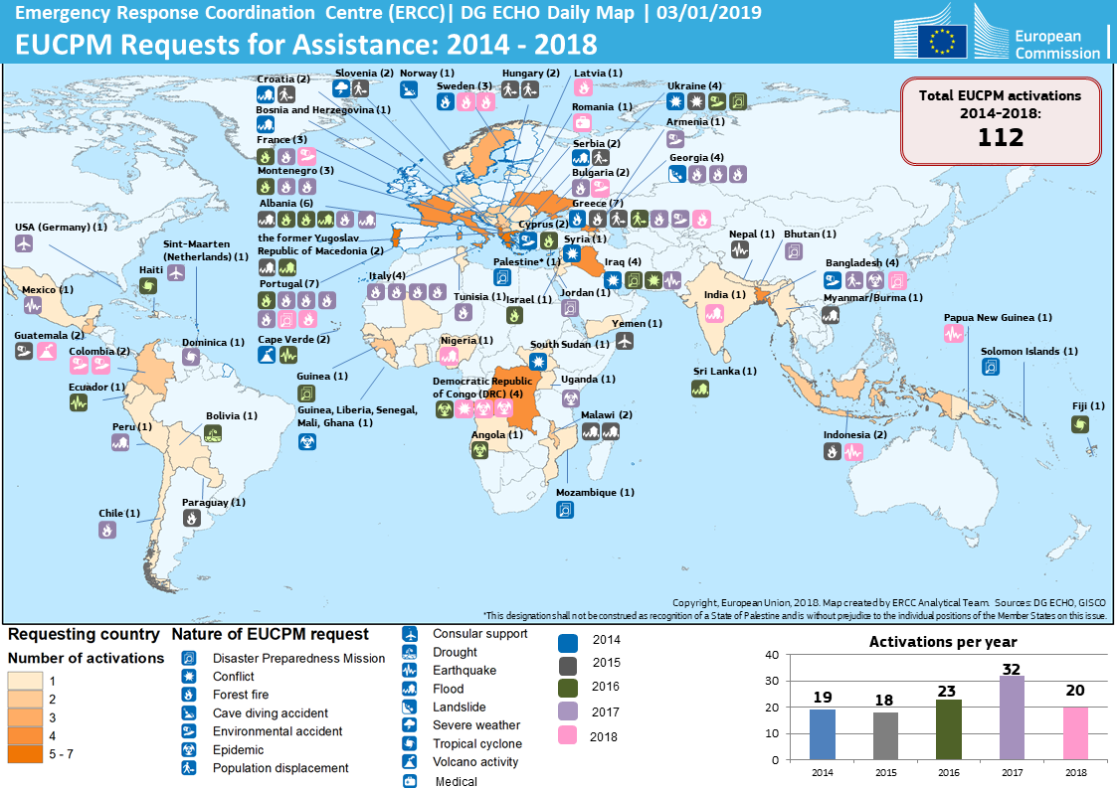

Slide 10
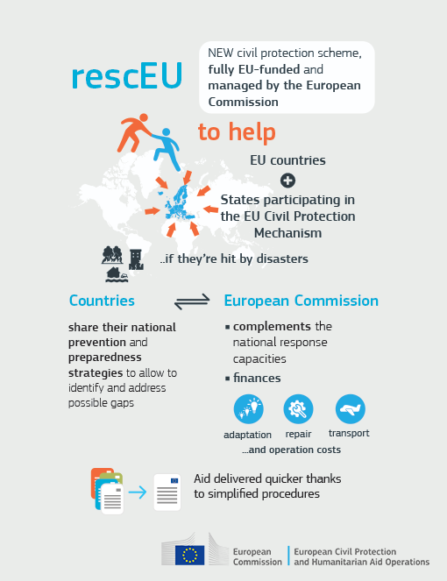
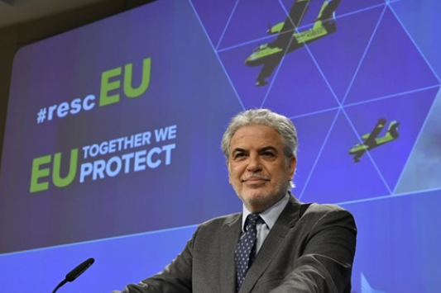
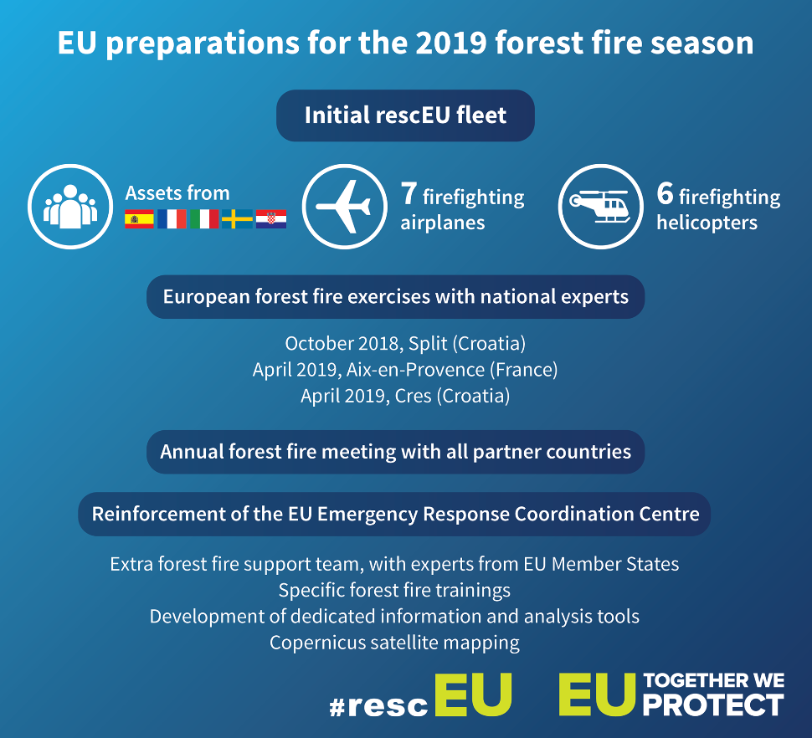
Notes:
The revised Union Civil Protection Mechanism will bolster the European civil protection system in order to respond to more frequent natural disasters and a changing risk landscape by investing in a better response, prevention and preparedness capacity of Member States.
The EU will strengthen its response capacities through:
Establishing, in collaboration with Member States, an additional reserve of capacities to respond to disasters. Such capacities would include firefighting planes, as well as other means to respond to situations such as medical emergencies or CBRN (chemical biological radiological and nuclear) incidents.
Co-financing the operational costs and development of rescEU capacities when used for the Union Civil Protection Mechanism’s operations;
Increasing financial support for capacities registered in the European Civil Protection Pool, including adaptation, repair, operational costs (inside the EU) and transport costs (outside the EU).
The EU will also step up support for Member States to improve their disaster risk management by:
Establishing a simplified reporting framework, focusing on key risks of cross-border nature and risks of low probability with high impact;
Helping Member States to increase preparedness and prevention measures by stimulating dialogue and exchange of knowledge, including deployment of experts and offering recommendations;
Setting up of a new EU Civil Protection Knowledge Network.

Slide 11
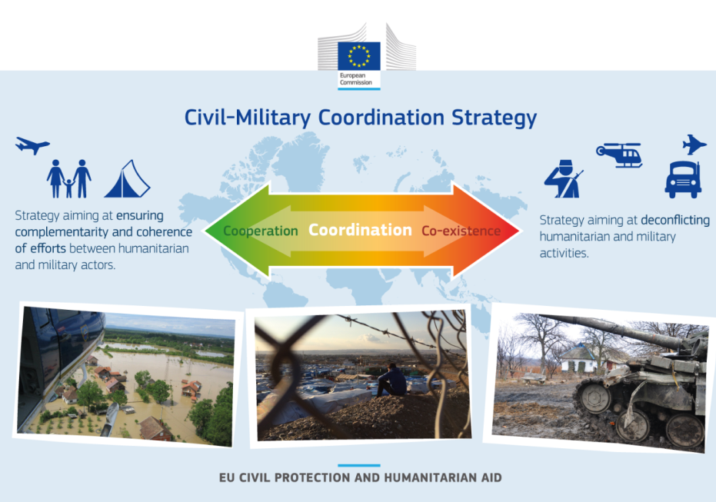
Humanitarian Civil-Military Coordination
Humanitarian Civil-Military Coordination = the essential dialogue and interaction between civilian and military actors in humanitarian emergencies necessary to protect and promote humanitarian principles, avoid competition, minimize inconsistency; and when appropriate, pursue common goals

Slide 12
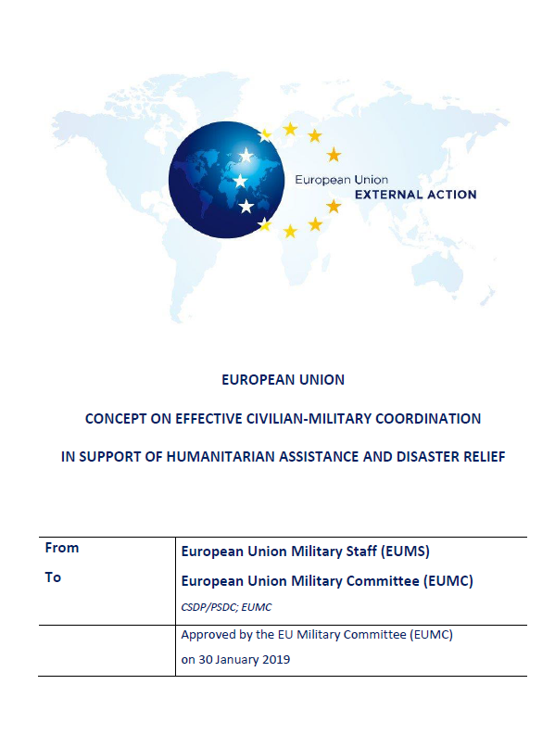
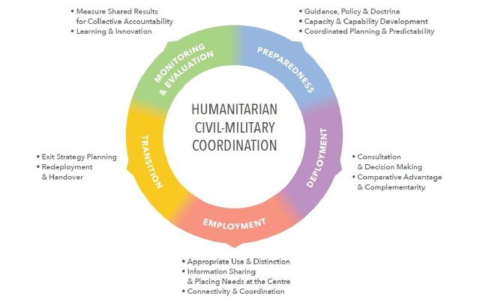
CIVMIL
EU Concept on Effective Civil-Military Coordination in Support of Humanitarian Assistance and Disaster Relief
Increase mutual understanding
Present concrete ways to work together and complement each other’s efforts
Respect each other’s mandates and sensitivities
Lessons learned, best practices, education, training & exercise
Link to the concept

Slide 13
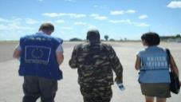
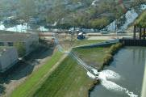
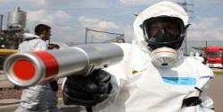
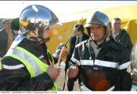
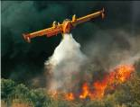
Thank you
Apostolos NIKOLAIDIS
apostolos.nikolaidis@ec.europa.eu
For more information:
http://ec.europa.eu/echo
European Commission - Humanitarian Aid & Civil Protection (ECHO)
EU humanitarian aid @eu_echo

