Slide 1
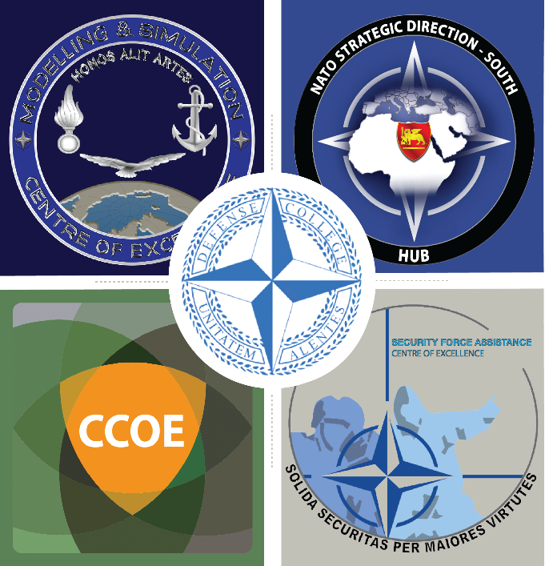
“Syndicate 8”

Slide 2
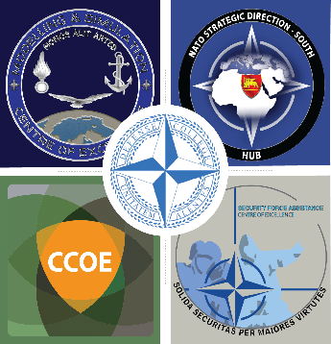
Group Session 2 – Concept Vision
STRENGTHS | WEAKNESSES
Abundant amount of research and analysis (6) Increasing level of interest in academic environment (2) The momentum of the political will (9) Communication and information technology (7) Social media (3) | Unwillingness to share information (local information) (5) National caveats on information sharing (national information)(8) Difficulty of building trust between partners (3) Biased perception of the NATO (Ex: Projecting Stability) (4) Validation problems (1) Difficulty of analyzing the huge quantity of information and clarification of the info process between civ-mil (6)
OPPORTUNITIES | THREATS
Facilitates early warning and pro-active posture (7) Feeds the strategic decision making cycle (5) Enhances the Strategic Communication (6) Increases awareness in terms of cultures, values and identities (8) | Due to the lack of synchronization, duplication of efforts (6) Mismanagement of the information exchange and process between civilian and military authorities (3)
Proposals: Permanent working groups to benefit from different fields Federated Network of Information (requires strong CIS infrastructure, as NSD-S Hub)

Slide 3
Group Session 2 – Themes
Theme 3: Development
Theme 1: Will/Ambition
National caveats/unwillingness at different levels on information sharing (national/local information)
The momentum of the political will
Abundant amount of research and analysis
Difficulty of analyzing the huge quantity of information and clarification of the info process between civ-mil
Increases awareness in terms of cultures, values and identities
Increases awareness in terms of cultures, values and identities
Theme 4: Policy
Enhances the Strategic Communication
Theme 2: Management
Mismanagement of the information exchange and process between civilian and military authorities
Due to the lack of synchronization, duplication of efforts
Communication and information technology
Facilitates early warning and pro-active posture

Slide 4
Group Session 3 – Operational Design: (90 mins)
Based on SWAT analyzes try to group the topics
proposal for an Operational Design and possible Lines of Effort
LoE1 | Ambition/Commitment/Will
LoE2 | Information Management
LoE3 | Knowledge Development
Loe4 | Policy Development

Slide 5
Group Session 3 – Operational Design
OBJECTIVES
DC
DC
LoE 1:
Ambition/
Commitment/Will
END STATE
Common Understanding of the Evolution of the Situation in the Region
In order to Project Stability
Collaboration
DC
DC
DC
LoE 2: Information Management
Shared Awareness
DC
DC
LoE 3:
Knowledge Development
Early Warning
LoE 4:
Producing Recommendations for Decision Makers
DC
DC
Prevention and Mitigation

Slide 6
Group Session 4 – Lines of Effort
High
Quick Wins?
Plan-Longer Term ?
LoE 4:
Producing Recommendations for Decision Makers
LoE 1: Ambition/
Commitment/Will
LoE 3:
Knowledge Development (Analysis)
Impact
(upon NATO)
LoE 2: Information Management (Sharing)
Consider ?
Ignore-Not Worth it?
Low
Low
Efforts
(required by NATO)
High

Slide 7
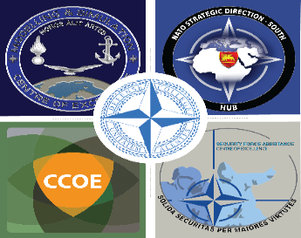
Group Session 4 – Milestones
LoE:2 | Information Management (Info-Exchange procedures and infrastructure, synchronization of efforts)
Current Objectives Comments | Positive: NSD-S Hub Negative: Isolated national ITs Interesting:
New Objectives-What is missing? | Shared IT Platform
Enablers i.e. opportunities to exploit | Gathering info from UN, EU, and available missions in the region Existing IT such as Palantir CIS/GIS Technologies FMN
Blockers i.e. constraints to progress | Classifications, privacy, national regulations, geographical distance, lack of trust, legal framework
Options- how can this LoE be implemented?
[opt] identify possible champions/actors

Slide 8
Cooperation between NATO-National Pol-Mil Leaders
Information Validation
IM Capacity Building of Partners
Education of KLs on IM
Interoperability with the Partners
Vetting Procedures
Classification Issues (Need to Share)
Training
Leadership
External SMEs
Doctrine
Additional IT/IKM Personnel
Inter-Disciplinary Working Groups
Personnel
EU/UN/AU/MD/AL/ICI and other partners
Organization
LoE2:Information Management (IM) (Sharing)
Partners/
Stakeholders
Mutual Trust
Relations with Intel Community
IOs and INGOs (Blue Shied and ICOMOS
Facilities
Infrastructure
Material/
Systems
Certification of Non-NATO members
Cooperation with Local Facilities
Linkage between Hub and FMN
Incorporation of
Artificial Intelligence
Access to the Hub products (compatibility of NFS and NCS CIS)
Additional CIS Hardware

Slide 9
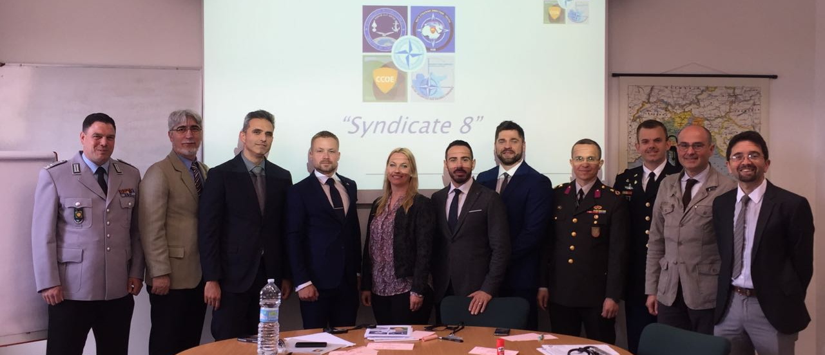
“Thank You for Your Attention”
“No questions, please”

Slide 10
Agenda 15th May
0830-0915 | Syndicate (work) Introduction | NDC Auditorium
0915-1100 | Syndicate work by groups 1 - 10 | Syndicate Rooms
1100-1130 | Coffee break & Discussions | Syndicate Rooms / NDC Lobby
1130-1300 | Syndicate work by groups 1 - 10 | Syndicate Rooms
1300-1400 | Lunch Break | NDC Dining Facility
1400-1500 | Syndicate work by groups 1 - 10 | Syndicate Rooms
1500-1530 | Coffee break | Syndicate Rooms / NDC Lobby
1530-1630 | Syndicate work by groups 1 - 10 | Syndicate Rooms

Slide 11
Syndicates
CIMIC & SFA utilizing projecting stability
CIMIC & SFA utilizing projecting stability
M&S in support of CIMIC assessments
Lebanon – a blueprint for CIMIC capability and capacity building
Lebanon – a blueprint for CIMIC capability and capacity building
Civil-military migration coordination at land and sea
Horizon scanning: Building an information network Strategic Direction South
Horizon scanning: Building an information network Strategic Direction South
Societal Resilience: The driving factor countering hybrid warfare
Societal Resilience: The driving factor countering hybrid warfare

Slide 12
Group Session 1 – Introductions: (45 mins)
Introduction
Syndicate rules
Self-introduction of all syndicate group members
Agree on the aim of the syndicate
Discuss selected questions to the topic

Slide 13
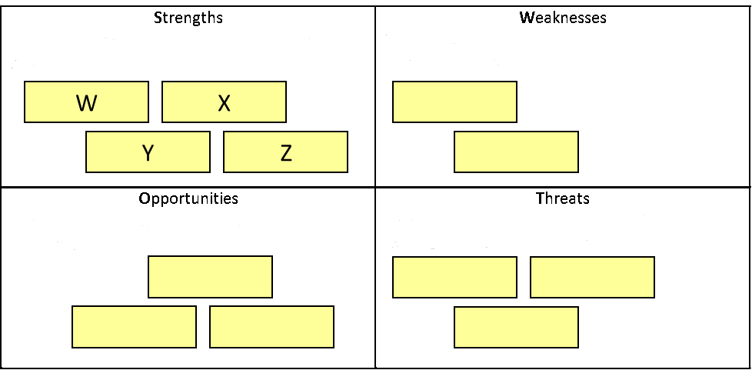
Group Session 2 – Concept Vision: (90 mins)
Brainstorm (create stickers)
SWOT (Strengths, Weaknesses, Opportunities, and Threats) analysis

Slide 14
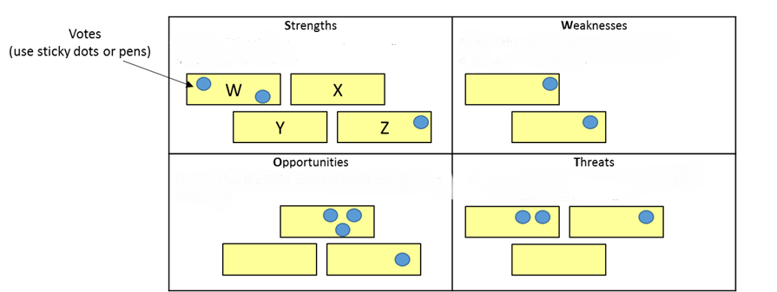
Still Group Session 2 – Concept Vision: (90 mins)
Prioritization

Slide 15
Group Session 3 – Operational Design: (90 mins)
Based on SWAT analyzes try to group the topics
proposal for an Operational Design and possible Lines of Effort

Slide 16
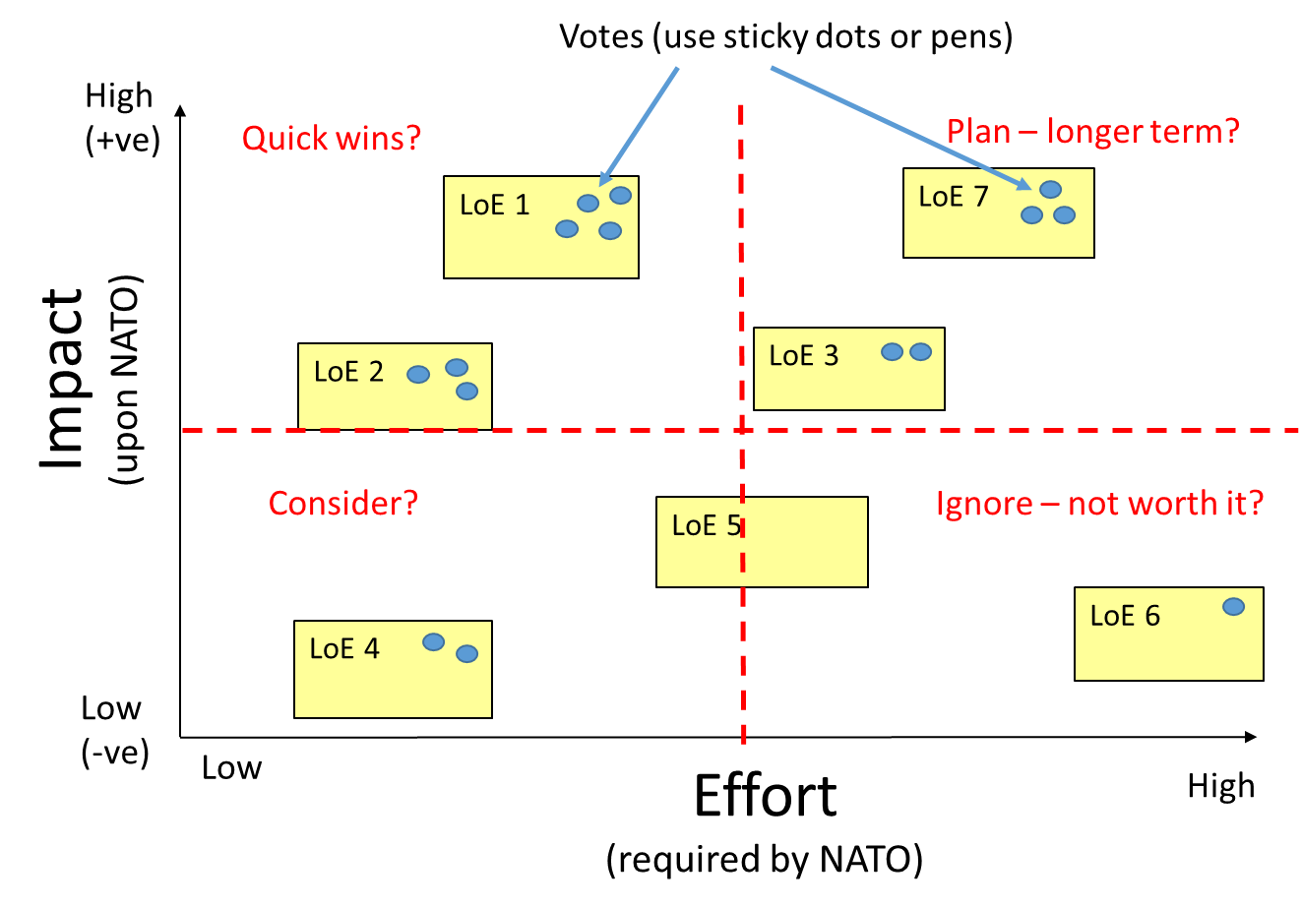
Group Session 4 – Lines of Effort: (90 mins)
Develop & prioritize LoEs
Which LoEs are relevant? Realistic? Achievable? Which is the most important one?

Slide 17
Group Session 4 – Milestones: (90 mins)
Develop the details in your most important Line of Effort

Slide 18
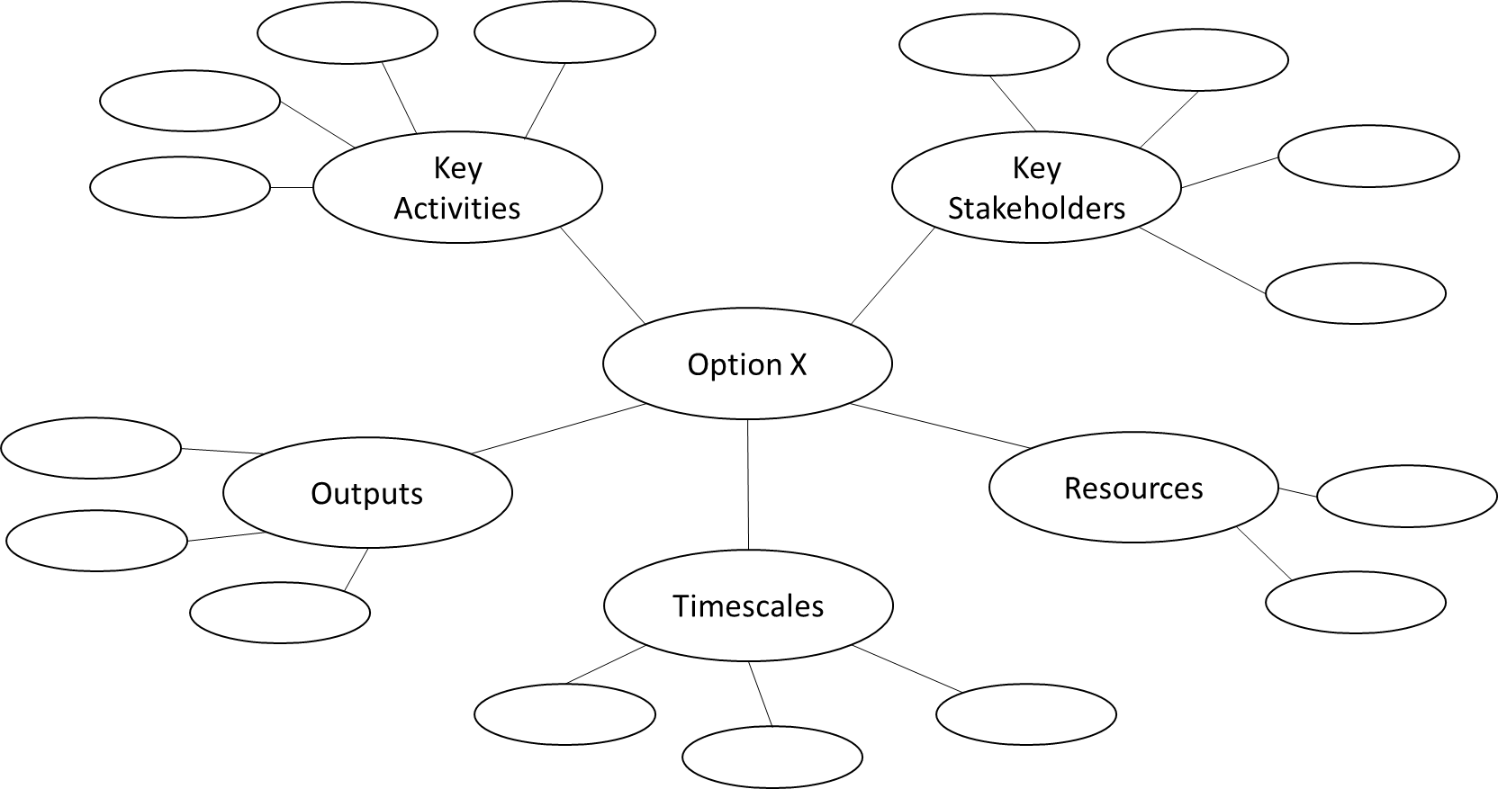
Group Session 5 – Milestones: (90 mins)
Produce a mind map to your most important Line of Effort

Slide 19
Group Session 6 – Presentation Preparation:
(90 mins)
Produce a 10-15 Minutes presentation on ppt
Cover shortly your syndicate work (way to the product)
Present your mind map to the audience and explain it
Agree on a presenter
Feedback session to the syndicate work

Slide 20
Side event CIMIC Vision 2025
On behalf of Allied Command Operations Branch head CIMIC
14:00 – 15:30 Introduced participants will be picked up from their syndicates
Kick off and discussions on ideas for next years Key Leader Conference
Input ideas from CCOE and German CIMIC Center for discussions
Output will be introduced to the Auditorium on Wednesday in the wrap up

Slide 22
Introduction of the moderators:
CIMIC & SFA utilizing projecting stability
CIMIC & SFA utilizing projecting stability
M&S in support of CIMIC assessments
Lebanon – a blueprint for CIMIC capability and capacity building
Lebanon – a blueprint for CIMIC capability and capacity building
Civil-military migration coordination at land and sea
Horizon scanning: Building an information network Strategic Direction South
Horizon scanning: Building an information network Strategic Direction South
Societal Resilience: The driving factor countering hybrid warfare
Societal Resilience: The driving factor countering hybrid warfare
Paul U-A-Sai
Attila Szamosi
Natalia Wojtowicz
Etienne Lavalette
Nick Pounds
Marian Corbe
Patriek Bakker
Thomas Hoehl
Rob Nicholson
Jan Brouwer

Slide 23
Syndicate rooms:

